Slide 1

Bachelor of Computer Application (BCA) – III
Semester - V
Compiler Construction
Unit – III
Dr Liladhar Rewatkar
M. Sc., M. Phil., Ph. D.
Assistant Professor,
Department of Computer Science
Prerna College of Commerce, Reshimbag, Nagpur

Slide 2
Lexical Analysis
Lexical analysis is the process of converting a sequence of characters into a sequence of tokens.
A program or function which performs lexical analysis is called a lexical analyzer, lexer or scanner.
A lexer often exists as a single function which is called by a parser.
The function of the lexical analyzer is to read the source program, one character at a time, and to translate it into a sequence of primitive units called tokens.
Keywords, identifiers, constants and operators are examples of tokens.

Slide 3
Role of Lexical Analyzer
A simple way to build lexical analyzer is to construct a diagram that shows the structure of the tokens of the source language, and then to translate the diagram into a program for finding tokens.
The lexical analyzer is the first phase of compiler. Its main task is to read the input characters and produces output a sequence of tokens that the parser uses for syntax analysis.
As in the figure, upon receiving a “get next token” command from the parser the lexical analyzer reads input characters until it can identify the next token.

Slide 4
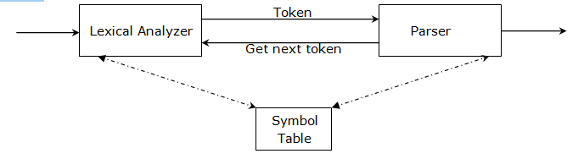
Role of Lexical Analyzer

Slide 5
Role of Lexical Analyzer
The lexical analyzer and parser are together in the same pass, the lexical analyzer act as a subroutine, which is called by the parser whenever it needs a new token.
The lexical analyzer returns to the parser a representation of the token it has found.
The representation is an integer code if the token is a simple construct such as left parenthesis.
The representation is a pair consisting of an integer code and a pointer to a table if the token is a more complex element such as identifier or constant.
The integer code gives the token type, the pointer to the value of that token.

Slide 6
Need of Lexical Analyzer
The lexical analyzer breaks an input stream of characters into tokens.
Writing lexical analyzer by hand is very difficult process. The main purpose of splitting the analysis of the source program into two different phases as lexical analysis and syntactic analysis is to simplify the overall design of the compiler.
It is easier to specify the structure of tokens than the syntactic structure of the source program.

Slide 7
Need of Lexical Analyzer
Lexical analyzer is more specialized, and hence more efficient, recognizer for tokens than for syntactic structures.
Lexical analyzer performs some functions like keeping track of line numbers, producing an output listing if necessary and deleting comments.

Slide 8
Approach to Design Lexical Analyzer
The design of any program is to describe the behavior of the program by a flowchart. When a program is lexical analyzer, the action taken is depends on what characters have been seen recently.
A specialized type of flowchart called transition diagram is used for lexical analyzer.
The boxes of the flowcharts are drawn as circles called states.
The states are connected by arrows, called edges.
The labels on the various edges having a state indicate the input characters that can appear after that state.

Slide 9
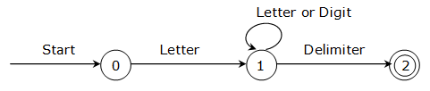
Approach to Design Lexical Analyzer
Figure 3.1 – Transition diagram for identifier or variable
A transition diagram for an identifier, defined to be a letter followed by any number of letters or digits.
The starting state of the transition diagram is state 0, the edge from which indicates that the first input character must be a letter.

Slide 10
Approach to Design Lexical Analyzer
If this is case, we enter state 1 and look at the next input character.
If that is an letter or digit, we re-enter state 1and look at the input character after that we continue this way, reading letters and digits and making transition from state 1 to itself, until the next input character is a delimiter for an identifier, which here we assume is any character that is not a letter or digit.
On reading the delimiter, we enter the state 2.

Slide 11
Approach to Design Lexical Analyzer
Consider the transition diagram of figure. The code for state 0 might be:
State 0: c = getchar();
if (letter(c))
goto state1;
else
fail();

Slide 12
Approach to Design Lexical Analyzer
Here, LETTER is a procedure which returns true if and only if C is a letter.
FAIL is a routine which reacts the look ahead pointer and starts up the next transition diagram, if there is one, or calls the error routine

Slide 13
Approach to Design Lexical Analyzer
The code for state 1 is:
State 1: c = getchar();
if (letter(c) || digit(c))
goto state1;
else
if (delimiter(c))
goto state 2;
else
fail();

Slide 14
Approach to Design Lexical Analyzer
DIGIT is a procedure which returns true if and only if C is one of the digits 0, 1, 2, 3, ----- 9. DELIMITER is a procedure which returns true whenever C is a character that could follow an identifier.
If we define a delimiter to be any character that is not a letter or digit, then the clause “if DELIMITER(C) then” need not be present in state 1

Slide 15

Approach to Design Lexical Analyzer
For Identifier-
Figure 3.2- Transition Diagram for Identifier

Slide 16

Approach to Design Lexical Analyzer
For Constant-
Figure 3.3- Transition Diagram for Constant

Slide 17
String and Language
A string is a finite sequence of symbols such as 001. Sentence and word are synonyms for string.
The length of a string x, denoted by |x| is a total number of symbols in x. For example, 01101 is a string of length 5.
A special string is the empty string, which we denote by ∈, string is of length zero.
If x and y are strings, then the concatenation of x and y, written x.y or just xy, is the string formed by following the symbols of x by the symbols y.

Slide 18
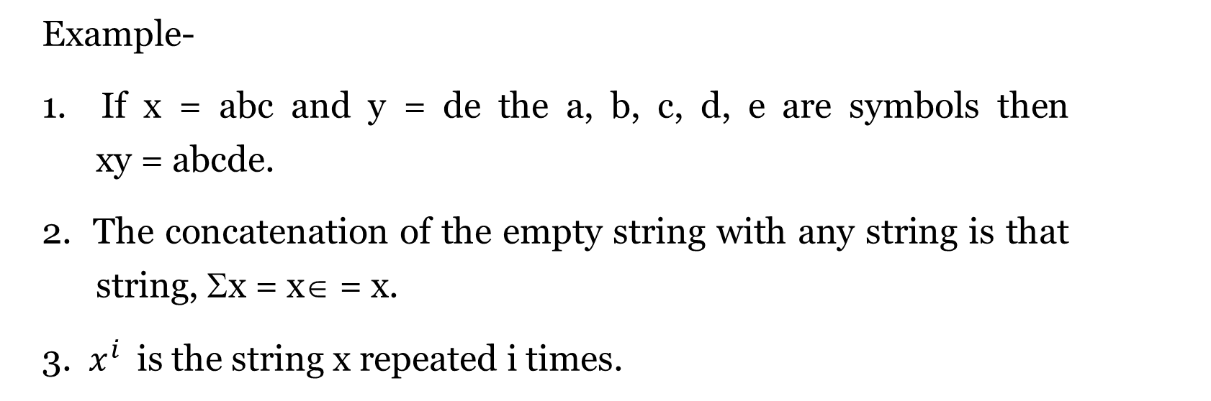
String and Language
Example-
1. If x = abc and y = de the a, b, c, d, e are symbols then xy = abcde.
2. The concatenation of the empty string with any string is that string, Σx = x∈ = x.
3. $x^{i}$is the string x repeated i times.

Slide 19
String and Language
Example-
4. If x is some string, then only string formed by discarding zero or more trailing symbols of x is called prefix of x. abc is a prefix of abcde. A suffix of x is the string formed by deleting zero or more of the leading symbols of x; cde is a suffix of abcde. A substring of x is any string obtained by deleting a suffix and prefix from x. Thus, for any string x, both x and e are prefixes, suffixes and substrings of x. any prefix or suffix of x is a substring of x.

Slide 20
String and Language
Language is any set of strings formed from some specific alphabet. Simple sets such as φ, the empty set having no members or {∈}, the set containing only the empty strings are languages under this definition.
If L and M are languages, then L.M or LM is the language consisting of all strings xy which can be formed by selecting a string x from L and a string y from M, concatenating them is that order. That is
LM = {xy / x is in L and y is in M}
Example- Let L be {0, 01, 110} and M be {10, 110}. Then LM = {010, 0110, 0110, 01110, 11010, 110110}

Slide 21
Implementation of Lexical Analyzer
There are several ways for implementing lexical analyzer.
Regular Expression-
Regular expression is a very useful notation suitable for describing tokens.
The notation we shall use to define the class of languages known as regular sets.
A token is either a single string such as a punctuation symbols or a one of the collection of strings of a certain type such as identifier.

Slide 22
Implementation of Lexical Analyzer
An identifier is defined to be a letter followed by zero or more letters or digits.
Identifier = letter (letter / digit)*
The sliding bar means “or”, that is union, the parenthesis are used to group sub expressions and the * is the closure operator meaning “zero or more instances”.
The regular expressions over alphabet are exactly these expressions that can be constructed from the following rules.
Each regular expression denotes the language and we give the rules for construction of the denoted language along with the regular expression construction rules.

Slide 23
Implementation of Lexical Analyzer
∈ is regular expression denoting {∈}, that is the language containing any empty strings.
For each ‘d’ in Σ, ‘a’ is a regular expression denoting {a}, the language with any number of string, that string consisting of the single symbol ‘a’.
If r and s are regular expression denoting language L(r) and L(s), respectively, then;
(R) / (S) is regular expression denoting L(r) ∪ L(s).
(R) . (S) is regular expression denoting L(r) . L(s).
(R) * is a regular expression denoting (L(r)) *

Slide 24

Implementation of Lexical Analyzer
Concatenation is a ‘product’ and union is a ‘sum’.
Example- ∑ is {a, b}. The regular expression ‘a’ denotes {a}, which is different from the string ‘a’.
The regular expression a* denotes the closure of the language {a}, that is a* = $\bigcup_{i=0}^{infinity}{\{}a^{i}$}
The set of all string of zero or more 0’s, the regular expression aa* denotes the string of one or more a’s.

Slide 25

Implementation of Lexical Analyzer
2) What does the regular expression (a/b) * denotes?
We see that a/b denotes {a, b}, the language with two string a and b. Thus (a/b)* denotes $\bigcup_{i=0}^{infinity}{\{}{a, b\}}^{i}$, which is a set of all strings a’s and b’s including empty string.
3) The expression a / ba* is grouped a / (b(a)*) and denoted the set of strings consisting of either a single a or b followed by zero or more a’s.
4) The expression aa / ab / ba / bb denotes all strings of length two, (aa / ab / ba / bb)* denotes all strings of even length.

Slide 26
Implementation of Lexical Analyzer
The tokens can be described by regular expression as follows
Keyword = if/else/for/while
Identifier = letter (letter / digit)*
Constant = digit+
Relational operator = < / <= / = / <> / > / >=

Slide 27
Implementation of Lexical Analyzer
If two regular expressions R and S denote the same language, we write R = S and R and S are equivalent.
R / S = S / R (/ is commutative)
R / (S / T) = (R / S) / T (/ is associative)
R(ST) = (RS)T (. Is associative)
R . (S/T) = RS / RT (. Is distributive over /)
E . R = R . E = R (E is the identity)

Slide 28
Implementation of Lexical Analyzer
Finite Automata-
Automation is defined to study useful machines under mathematical formalism.
So, the definition of an automation can be given as “An automation which is supposed to run one some given sequence of inputs in discrete time steps.”
At each time step, it gets an input which is fed to automation to form a finite sequence of inputs (alphabets, symbols etc.) called as string.

Slide 29
Implementation of Lexical Analyzer
Finite automation consists of set of states, set of input symbols, transition function, initial state and set of final state.
A recognizer for a language L is a program that takes as input a string x and answer “yes” if x is a sentence of L and “no” otherwise.

Slide 30
Implementation of Lexical Analyzer
Non-deterministic Automata
Non deterministic automation is a finite automation in which two or more edges leading away from a node are labeled with the same symbol.
In general we need a nondeterministic automation (NFA) to recognize a regular expression.
The better way is to convert a regular expression to a recognizer is to construct a generalized transition diagram from the expression.
This diagram is called nondeterministic finite automata. A non-deterministic finite automata recognizing the language (a/b) *abb is shown in figure 3.4.

Slide 31


Implementation of Lexical Analyzer
This diagram is called nondeterministic finite automata.
A non-deterministic finite automata recognizing the language ${(\frac{a}{b})}^{∗}$abb is shown in figure 3.4.
Figure 3.4 – A Nondeterministic Finite Automata
Nondeterministic finite automation is labeled directed graph.
The nodes are called states, and the labeled edges called transitions.

Slide 32
Implementation of Lexical Analyzer
The NFA looks like a transition diagram, but edges can be labeled ∈ as well as characters or some character can label two or more transitions out of one state and one or more states may be distinguished as accepting states or final states.
The transition of an NFA can be conveniently represented in tabular form by means of transition table.
The transition table for the NFA of above figure is shown in the following figure.
In the transition table, there is a row for each state and a column for each admissible input symbol and ∈ if necessary.

Slide 33
Implementation of Lexical Analyzer
Transition table for NFA
The NFA accepts an input string x, if and only if there is a path from the state to some accepting state.
STATE | INPUT SYMBOL
 | A | B
0 | {0, 1} | {0}
1 | -- | {2}
2 | -- | {3}

Slide 34
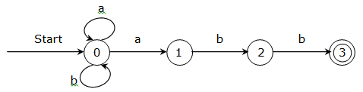
Implementation of Lexical Analyzer
Deterministic Automata
The following figure has more than one transition from state 0 on input a, that is, it may go to state 0 or 1.
Figure 3.5- NFA for (a/b)*abb
Similarly, the NFA of figure 3.5 has two transitions from state 0.

Slide 35
Implementation of Lexical Analyzer
These situations, in which the transition function is multivalued, hence it is hard to simulate an NFA with a computer program.
If there are many paths with the same label string, we may have to consider them all before we find an accepting state.
So, there is a deterministic version of the finite automata which can be simulated in a straightforward manner.
A deterministic finite automaton has at most one path from the start state labeled by any string.

Slide 36
Implementation of Lexical Analyzer
We say a finite automation is deterministic if,
1. It has not transition on input.
For each state S and input symbol A, there is at most one edge labeled a leaving S.
Example- the following diagram is a deterministic finite automation accepting the language (a/b)*abb, which is the same language as that accepted by the NFA of figure 3.5.

Slide 37
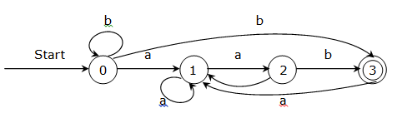
Implementation of Lexical Analyzer
Figure 3.6- DFA accepting a(/b)*abb
Since, there is at most one transition out of any state on any input symbol, a DFA is easier to simulate by a program than is an NFA.
To simulate a DFA, we can create a piece of program for each state.

Slide 38
Implementation of Lexical Analyzer
From Regular Expression to Finite Automata
To determine whether a string is in the language denoted by a regular expression is a task easily performed by a deterministic finite automation.
A regular expression is a natural notation for describing the language of a token.
Following is the method to convert the regular expression to the deterministic finite automation.

Slide 39
Implementation of Lexical Analyzer
1. Consider the following grammar,
S → a/^/(T)
T → T, S/S
Find (a, (a, a))

Slide 40
Implementation of Lexical Analyzer
Solution- RMD (Right Most Derivation)
S → (T) Since S → (T)
S → (T, S) Since T → T, S
S → (T, (T)) Since S → (T)
S → (T, (T, S)) Since S → T, S
S → (T, (T, a)) Since S → a
S → (T, (S, a)) Since T → S
S → (T, (a, a)) Since S → a
S → (T, (a, a)) Since T → S
S → (a, (a, a)) Since S → a

Slide 41
Implementation of Lexical Analyzer
Solution- LMD (Left Most Derivation)
S → (T) Since S → (T)
S → (T, S) Since T → T, S
S → (S, S) Since T → S)
S → (a, S) Since S → (T)
S → (a, T) Since T → T, S
S → (a, (T, S)) Since T → S
S → (a, (S, S)) Since S → a
S → (a, (a, S)) Since S → a
S → (a, (a, a)) Since S → a

Slide 42
Implementation of Lexical Analyzer
2. Check whether grammar is ambiguous or not.
a) S → aSbS / bSaS / ∈
Solution- Grammer G is ambiguous if any string w ∈ L(G) (at least one string) is ambiguous. And we know the string w is ambiguous if for string w we can draw more than one parse tree having same type of derivation
Here we try to derive the string abab using LMD in two ways as follows.

Slide 43
Implementation of Lexical Analyzer
LMD 1-
S → aSbS Since S → aSbS
S → a∈bS Since S → ∈
S → abS
S → abaSbS Since S → aSbS
S → aba∈bS Since S → ∈
S → ababS
S → abab∈ Since S → ∈
S → abab

Slide 44
Implementation of Lexical Analyzer
LMD 2-
S → aSbS Since S → aSbS
S → abSaSbS Since S → aSbS
S → ab∈aSbS Since S → ∈
S → abaSbS
S → aba∈bS Since S → ∈
S → ababS
S → abab∈ Since S → ∈
S → abab

Slide 45
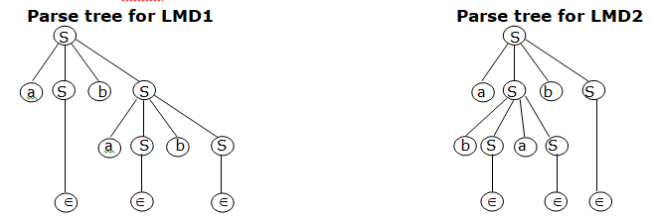
Implementation of Lexical Analyzer
Here, we derive the string abab using LMD in two different ways and hence we have drawn two different parse trees for the string w = abab.
So, the string abab is ambiguous and as w ∈ L(G), given grammar G is also ambiguous.

Slide 46
Implementation of Lexical Analyzer
b) S → aSbS / aS / c
Solution-
LMD 1-
S → aSbS since S → aSbS
S → acbS since S → c
S → acbc since S → c
LMD 2-
S → aSbS since S → aSbS
S → aaSbS since S → aS
S → aacbS since S → c
S → aacbc since S → c
Given grammar is not ambiguous

Slide 47
Implementation of Lexical Analyzer
c) S → aSSb / bSSa / ∈
LMD1
S → aSSb since S → aSSb
S → abSSaSb since S → bSSa
S → ab∈SaSb since S → ∈
S → abSaSb
S → ab∈aSb since S → ∈
S → abaSb
S → aba∈b since S → ∈
S → abab

Slide 48
Implementation of Lexical Analyzer
LMD2
S → aSSb since S → aSSb
S → a ∈ Sb since S → ∈
S → aSb
S → abSSab since S → bSSa
S → ab ∈ Sab since S → ∈
S → abSab
S → ab ∈ ab since S → ∈
S → abab
Here we derived the string abab using LMD in two different ways and hence, string is ambiguous.

Slide 49
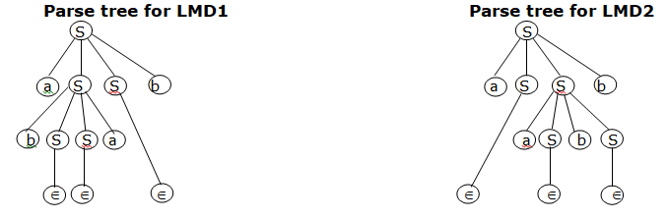
Implementation of Lexical Analyzer

Slide 50
Context Free Grammar
A notation for the syntactic structure of programming language is called as context free grammar or simply grammar.
A context free grammar consist of a set of Non-terminals, a set of Terminals, a set if production and a single set of start symbol from the set of non-terminals.
The non-terminal is a grammar can be thought of as a variable because during the course of parsing a grammar, the non-terminals get changed.

Slide 51
Context Free Grammar
The terminal symbol can be thought of constant in a context free grammar as the terminal symbol cannot be changed. This language consists of all strings of terminal symbols that can be formed using the rules of the grammar. The language of the grammar G is referred as L(G).
A context free grammar G is defined as
G = (V, T, P, S)

Slide 52
Context Free Grammar
Where,
V- Finite set of Non-terminals i.e. variables. Non-terminals symbols are syntactic variables or syntactic category that denotes the set of strings. These set of strings help to define the language generated by the grammar.
T- Finite set of Terminals. Terminals are the basic symbols from which strings are formed. The word “token” is a synonym for terminal.

Slide 53
Context Free Grammar
P- Finite set of productions. The productions of the grammar are rewriting rules that specify the manner in which the terminals and non-terminals can be combined to form strings. Each production consists of non-terminals, followed by an arrow, followed by a string of non-terminals and terminals.
S- Is the unique start symbol. In a grammar, one non-terminal is distinguished as the start symbol and the set of strings denoted by it is the language defined by the grammar.

Slide 54
Context Free Grammar
Notational Conventions
1) These symbols are generally referred as non-terminals
Lower-case names such as expression, statement, operator etc.
Italic capital letters near the beginning of the alphabet
The letter S, which when it appears, is usually the start symbol

Slide 55
Context Free Grammar
Notational Conventions
2) These symbols are
Single lower-case letters a, b, c, …….
Operator symbols such as +, -, *, /, etc.
Punctuation symbols such as comma, parenthesis etc.
The digits 0, 1, 2, 3, ………….., 8, 9
The boldface strings such as id or if

Slide 56
Context Free Grammar
3) Capital symbols near the end of the alphabets, mainly X, Y, Z represent grammar symbols that is either terminals or non-terminals
4) Small letters near the end of the alphabet, mainly u, v, ….. z represents strings of terminals.
5) Lower-case Greek letters indicates that there is a single non-terminal. ‘A’ which is present on the left side of the arrow and a string of grammar symbols ? to the right side of the arrow.

Slide 57

Context Free Grammar
6) If A →$∝_{1}$, A → $∝_{2}$, A → $∝_{k}$, are all productions with A on the left (called as the A productions), we may write A → $∝_{1}$ / $∝_{2}$ / …… /$∝_{k}$, and we say $∝_{1}$, $∝_{2}$, …… $∝_{k}$, are the alternatives for A.
Unless otherwise stated, the left side of the first production is the start symbol.
Example- Using the above notations, we can write grammar as
E → EAE / (E) / id
A → + | - | * | / | ↑
From the above notational conventions, we say that E and A are the non-terminals, where E is the start symbol and remaining symbol are the terminals.

Slide 58
Derivations
A derivation in a grammar refers to the replacement of an instance of non-terminals in a given string by the right had side of that production rule, whose left hand side is the non-terminal to be replaced.
Derivation produces a new string from a given string; therefore derivation can be used repeatedly to obtain a new string from a given string.
If a string obtained only terminal symbols then no further derivations are possible.

Slide 59
Derivations
For example- consider the grammar G = ({S, A}, {a, b}, P, S) where P consist of the productions as follows
S → aAS | a
A → SbA | SS | ba
From the above grammar we can derive the string “aabbaa” as follows.
S → aAS since S → aAS
→ aSbAS since S → SbA
→ aabAS since S → a
→ aabbaS since S → ba
→ aabbaa since S → a

Slide 60
Derivations
Derivation can be made in two different ways depending on the non-terminals to be placed, which are as follows
1) Rightmost Derivation
2) Leftmost Derivation
Rightmost Derivation- If at each step in a derivation of a production is applied to the right most variable, then such a derivation is called as Rightmost derivation.

Slide 61
Derivations
For example- consider the grammar
S → aAS | a
A → SbA | SS | ba
Then rightmost derivation is given by
S → aAS since S → aAS
→ aAa since S → a
→ aSbAa since A → SbA
→ aSbbaa since A → ba
→ aabbaa since S → a

Slide 62
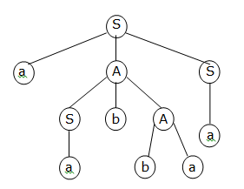
Derivations
Parse Tree for Rightmost Derivation

Slide 63
Derivations
Leftmost Derivation- If at each step in a derivation of a production is applied to the left most variable, then such a derivation is called as Leftmost derivation.
For example- consider the grammar
S → aAS | a
A → SbA | SS | ba
Then leftmost derivation is given by
S → aAS since S → aAS
→ aSbAS since A → SbA
→ aabAS since S → a
→ aabbaS since A → ba
→ aabbaa since S → a

Slide 64
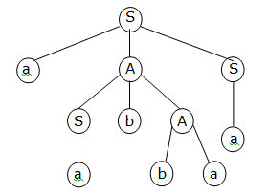
Derivations
Parse Tree for Leftmost Derivation

Slide 65
Parse Tree
A parse tree / derivation tree is an equivalent form of showing a derivation of a production which represent a derivation graphically.
A parse tree for grammar G = (V, T, P, S) is a tree which represents derivations graphically having following requirements.
1. The root node of the tree is labeled by the start symbol, S of the grammar.
2. All interior nodes are labeled with non-terminals i.e. variables
3. All the leaf nodes of the tree are labeled by the terminals of the grammar.

Slide 66
Parse Tree
4. If an interior node has a label A, and has a N descendants with labels X1, X2….Xn from left to right, then there must be a production A  X1, X2, … Xn in the grammar.
For example- Consider the grammar
E → E + E
E → E * E
E → (E)
E → id

Slide 67
Parse Tree
The string id + id * id has the left most derivation as below,
E → E + E since E → E + E
E → id + E since E → id
E → id + E * E since E → E * E
E → id + id * E since E → id
E → id + id * id since E → id

Slide 68
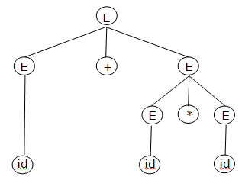
Parse Tree
And the parse tree for this left most derivation is shown as below,
Parse Tree for id + id + id

Slide 69
Ambiguous Grammar
A context free grammar is said to be ambiguous if there exist more than one parse tree for same string w in the language of the grammar i.e. W ∈ L(G) using either leftmost or rightmost derivation.
A grammar is ambiguous appears twice on the right hand side.
Example 1- Consider the grammar having the following productions.
S → SAS / a
B → b

Slide 70
Ambiguous Grammar
The above grammar is ambiguous because we can draw two different parse trees for the grammar as follows.
Leftmost Derivation 1
S → SBS since S → SBS
S → aBS since S → a
S → abS since B → b
S → abSBS since S → SBS
S → abaBS since S → a
S → ababS since B → b
S → ababa since S → a

Slide 71
Ambiguous Grammar
Leftmost Derivation 2
S → SBS since S → SBS
S → SBSBS since S → SBS
S → aBSBS since S → a
S → abSBS since B → b
S → abaBS since S → a
S → ababS since B → b
S → ababa since S → a

Slide 72
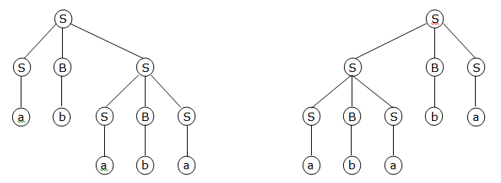
Ambiguous Grammar
Parse trees for above derivations are
Parse Tree for Derivation 1 Parse Tree for Derivation 2

Slide 73
Ambiguous Grammar
Example 2- Consider the grammar with following productions
E → E + E
E → E * E
E → (E)
E → id
Check whether the grammar is ambiguous or not?
Here we will try to derive the string w = id + id * id using leftmost derivation in two different ways as follows,

Slide 74
Ambiguous Grammar
Leftmost Derivation 1
E → E + E since E → E + E
E → id + E since E → id
E → id + E * E since E → E * E
E → id + id * E since E → id
E → id + id * id since E → id
Leftmost Derivation 2
E → E * E since E → E * E
E → E + E * E since E → E + E
E → id + E * E since E → id
E → id + id * E since E → id
E → id + id * id since E → id

Slide 75
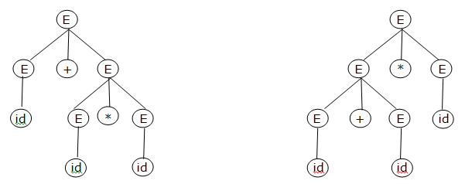
Ambiguous Grammar
Parse tree for the above derivations are as follows
Parse tree for Derivation 1 Parse tree for Derivation 2
We can represent the given grammar using more than one parse trees as above, so the given grammar G is ambiguous

Slide 76
Disambiguous Grammar
Ambiguous productions are those productions which have more than one occurrence of a given non-terminal on their right hand side.
We can apply the certain transformations to eliminate the ambiguity to disambiguate the grammar.
Let us consider the context free grammar, which is already ambiguous.
We know several operators have different precedence and the grammar rules for expression involving these operators must be written in such a way that their relation precedence are preserved.

Slide 77

Disambiguous Grammar
The operation *, / have higher precedence over +, -.
Consider the following CFG
S → αSβr / ${\text{}}_{1}$/ ${\text{}}_{2}$ … / ${\text{}}_{n}$
Here we can remove ambiguity by moving the right most of these non-terminals further down the parse tree by introducing the new non-terminals.
So we can rewrite the production rate to eliminate the ambiguity as follows
S → αSβrS’r / S’
S’ → ${\text{}}_{1}$/ ${\text{}}_{2}$ … / ${\text{}}_{n}$

Slide 78
Disambiguous Grammar
If a grammar has more than one ambiguous production, it can be modified by repetitive application of this transformation.
Consider the grammar, with following ambiguous productions.
E → E + E
E → E * E or E → E + E / E * E / (E) / id
E → (E)
E → id
Here we introduce the another non-terminal T so that the rules for the operator with lower precedence are
E → E + T / T
T → E * E / (E) / id

Slide 79
Disambiguating a Grammar
As we have the production E → T, we can substitute E with T so that we get T → T * T. Now we introduce another non-terminal F, to disambiguate this rule.
Therefore, the unambiguous grammar, equivalent to the given CFG is as follows.
E → E + T / T
T → T * F / F
F → (E) / id

